Slide 1

Christopher B. Barrett, Cornell University
15th Annual George McGovern Lecture
US Mission to the United Nations Agencies in Rome
April 4, 2019
On Science and Solidarity: Innovations to Meet Global Food Security Challenges

Slide 2
Food security is essential to human flourishing
Food security exists if and only if
“all people at all times have physical, social, and economic access to sufficient, safe and nutritious food that meets their dietary needs and food preferences for an active and healthy life”
(1996 World Food Summit definition, emphasis added)

Slide 3
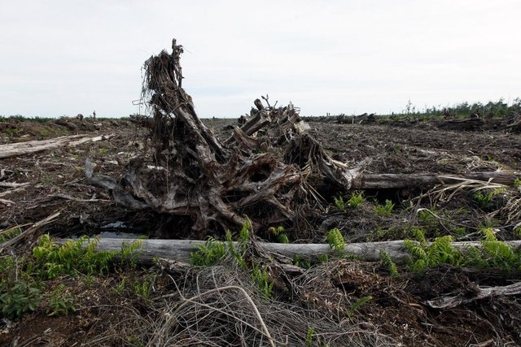

Food security may be the defining global challenge of the century …
The stability of social order and the protection of the planet depend on rapid, inclusive progress.
Photo credits: CIFOR, Bloomberg

Slide 4
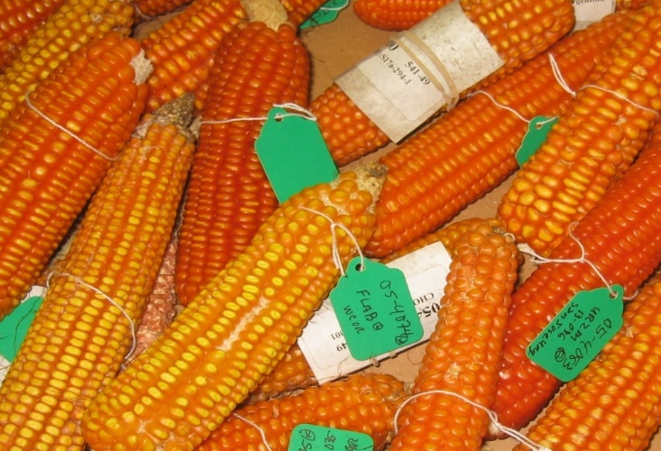

If the stability of social order and the protection of the planet depend on rapid, inclusive progress,
then we must be progressive in both senses:
Have faith in science as an engine of advance
Show solidarity with the poor
Photo credits: Mike Gore, Holly Kristinsson, Forward Press

Slide 5
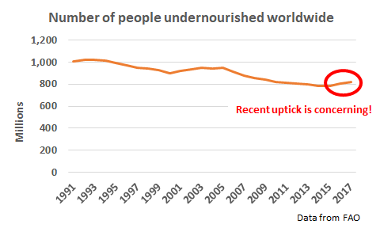
Reason for concern

Slide 6
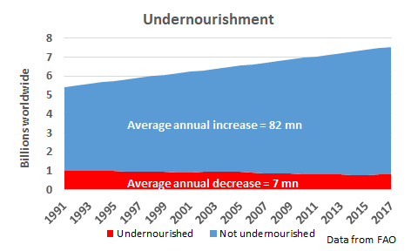
But also remarkable progress
Global population grew from 5.4 - 7.5 billion over same period … >2 bn more people adequately nourished in a quarter century.

Slide 7
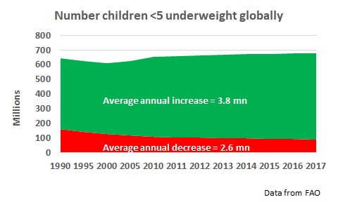
Remarkable progress
Also steady progress reducing children underweight for age

Slide 8
Remarkable progress
Food systems successes in 1940s-80s enabled dramatic poverty reduction and improved standards of living
Today >6.5 (~3.5-4) bn people have adequate calories (micronutrients), up from only about 2 (1) bn just 50 years ago.
Public/private ag R&D and policy reforms led productivity growth to outpace demand growth, increasing land/water efficiency use, and steadily lowering real food prices, lifting hundreds of millions from poverty and hunger.
… and induced a dangerous complacency.

Slide 9
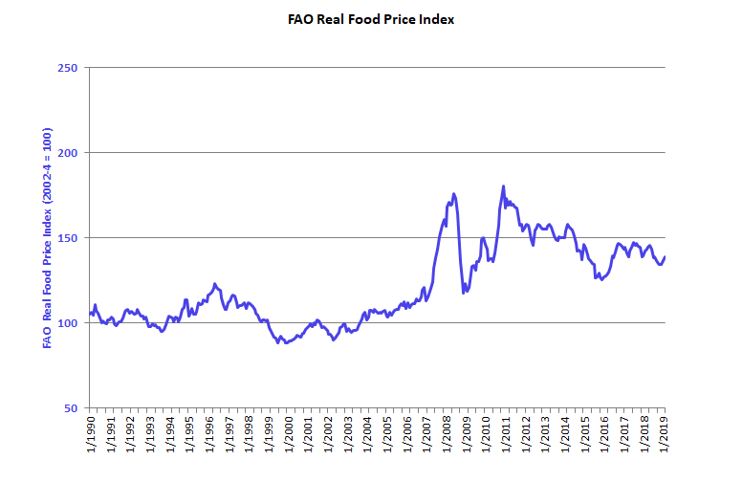
Stagnation
Complacency led to underinvestment in innovations. Supply growth slowed relative to demand growth. Result: higher prices.
Most forecasts predict non-decreasing food prices over the next 20 years as demand growth > supply expansion worldwide.

Slide 10
Stagnation
Much less progress on micronutrient deficiencies:
1.6 bn suffer iron- or vitamin B₁₂ deficiency anemia
… and growing!
33/15% of pre-school age children/pregnant women at risk of vitamin A deficiency
zinc deficiency prevalence 40-70% in low-income Asia/Africa
Sources: FAO et al. 2017; WHO 2008, 2009.
We lack rigorous, recent estimates of the population suffering shortfalls of any one or more nutrient, although the number is surely >2 bn. We can’t manage what we don’t measure!

Slide 11
Growing challenges
Future challenges may be tougher than past
1. Human suffering is more spatially concentrated and more tied to conflict. In 1990 Africa home to 119 mn (24%) of the world’s ultra-poor (<$0.95/day pc) … grew to 133 mn (82%) by 2011. Poverty traps increasingly salient to the remaining poor.
2. Planetary boundaries increasingly bind. And climate change creates a previously unobserved context.
Water/climate/soil nutrient constraints + changing pest/pathogen pressures = new production challenges

Slide 12
Growing challenges
It helps to unpack by the four pillars of food security, each of which is necessary (can’t focus just on one):
Availability: Food must be available in sufficient quantities. Supply-side necessary condition that considers production flows and carryover stocks available locally from production, trade, or aid.
Access: People must be able to regularly acquire adequate quantities of food. Demand-side necessary condition that considers purchase, home production, barter, gifts, borrowing, and safety nets.
Utilization: Consumed food must have a positive nutritional impact. Nutrient composition, cooking/hygiene/WASH, and disease status are key.
Stability: Must be able to maintain access and utilization over time, through lean seasons, disasters, price spikes, etc. Resilience is key.

Slide 13
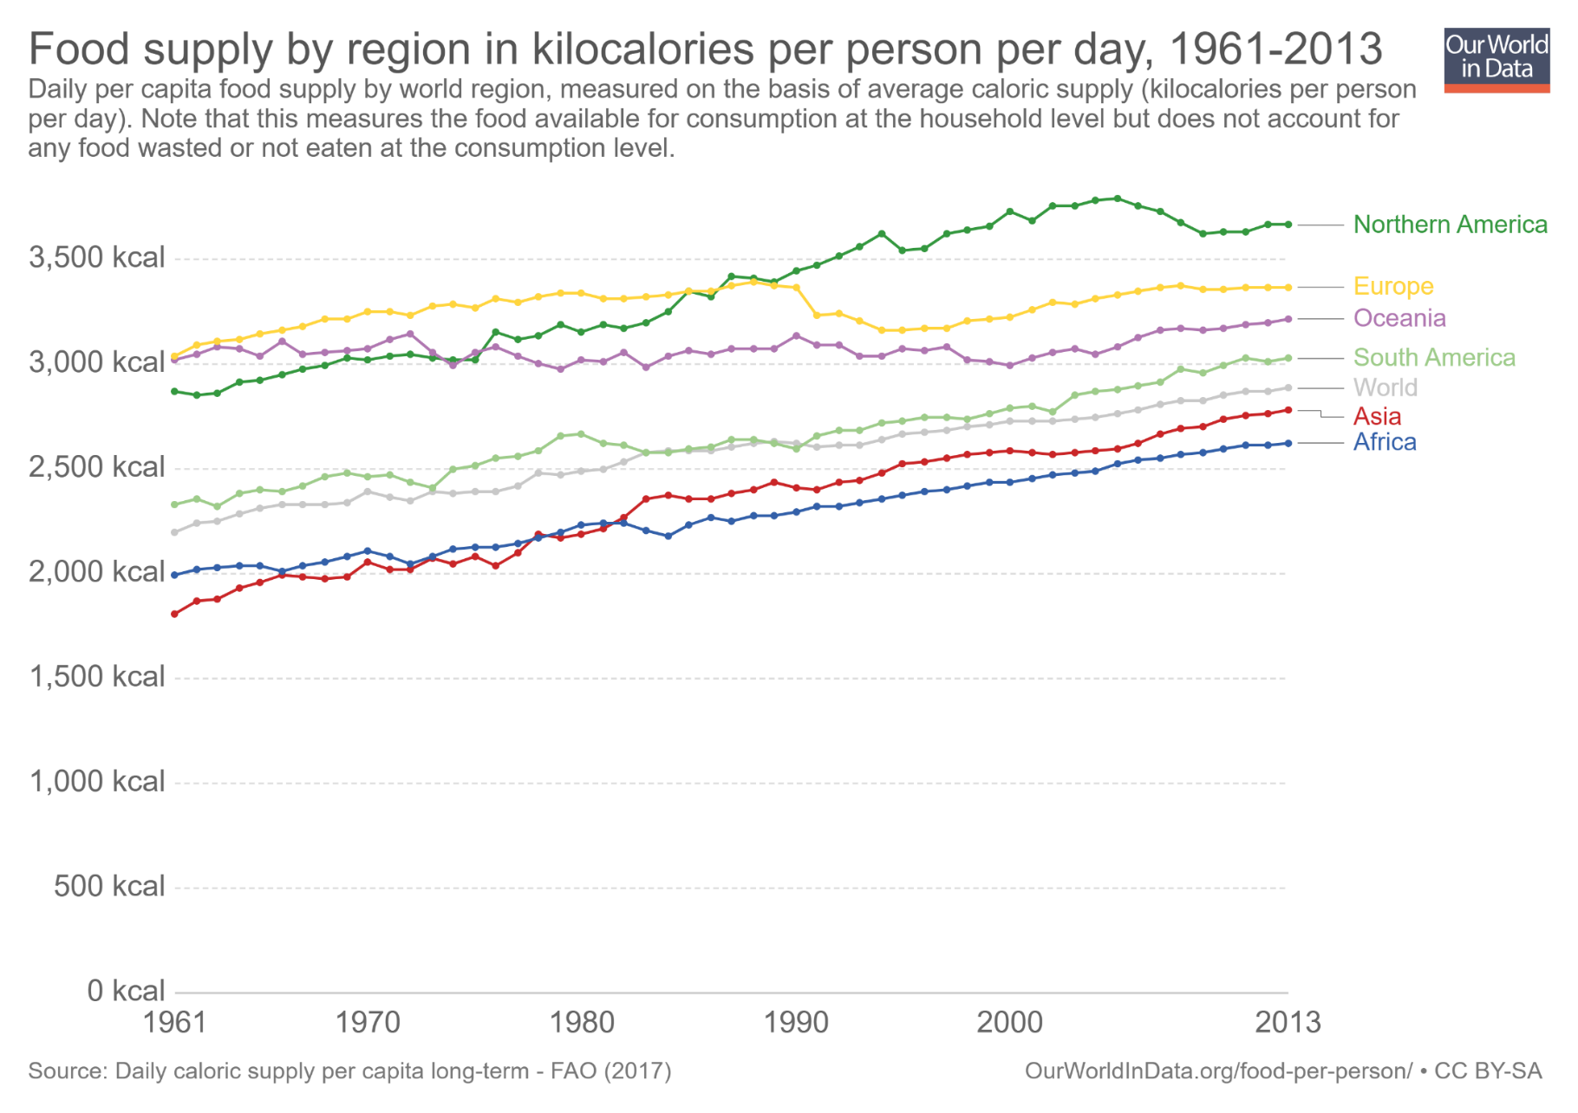
Availability progress
Great progress in raising calorie availability …
2011-13 min. dietary energy req’t [1770,2340]

Slide 14
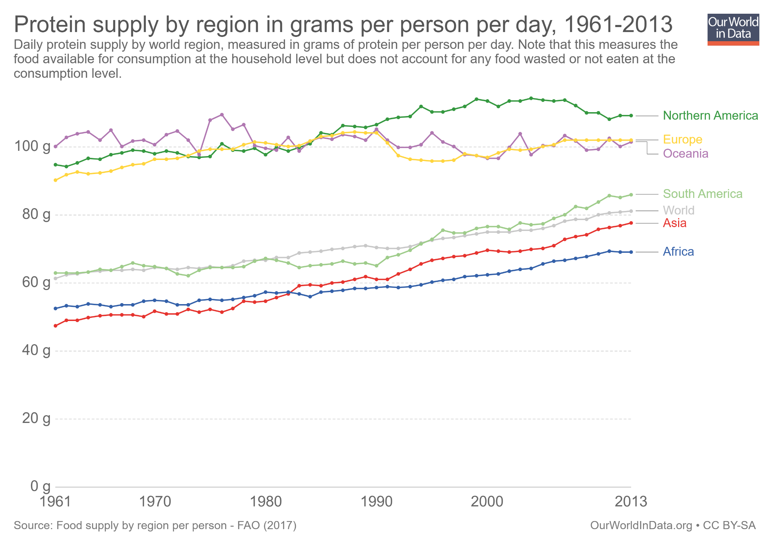
Availability progress
… and protein availability
Daily protein req’t:
45-55 g/day global avg
(0.8g p/kg body weight)

Slide 15
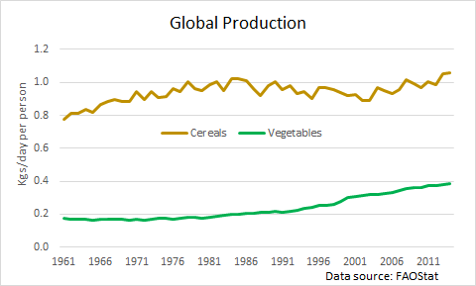
Availability challenges
Challenge: Vitamin/mineral rich food supply not growing fast enough for diet transition (Bennett’s Law)
Especially true given loss/waste rates ≥50% higher for vegetables due to perishability and vitamin loss, and relative price increases due to differences in demand elasticities.

Slide 16
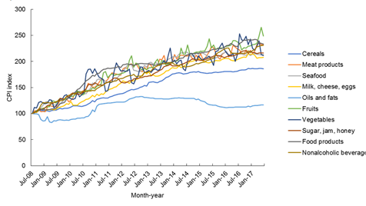
Availability challenges
Result: relative prices of more nutritious foods increase faster than less nutritious foods
Example: In Pakistan, fruit/veg/ASF prices have increased 2-2.5x those of oils/fats and 25-75% > cereals
(Source: Dizon & Herforth 2018 WB PRWP)

Slide 17
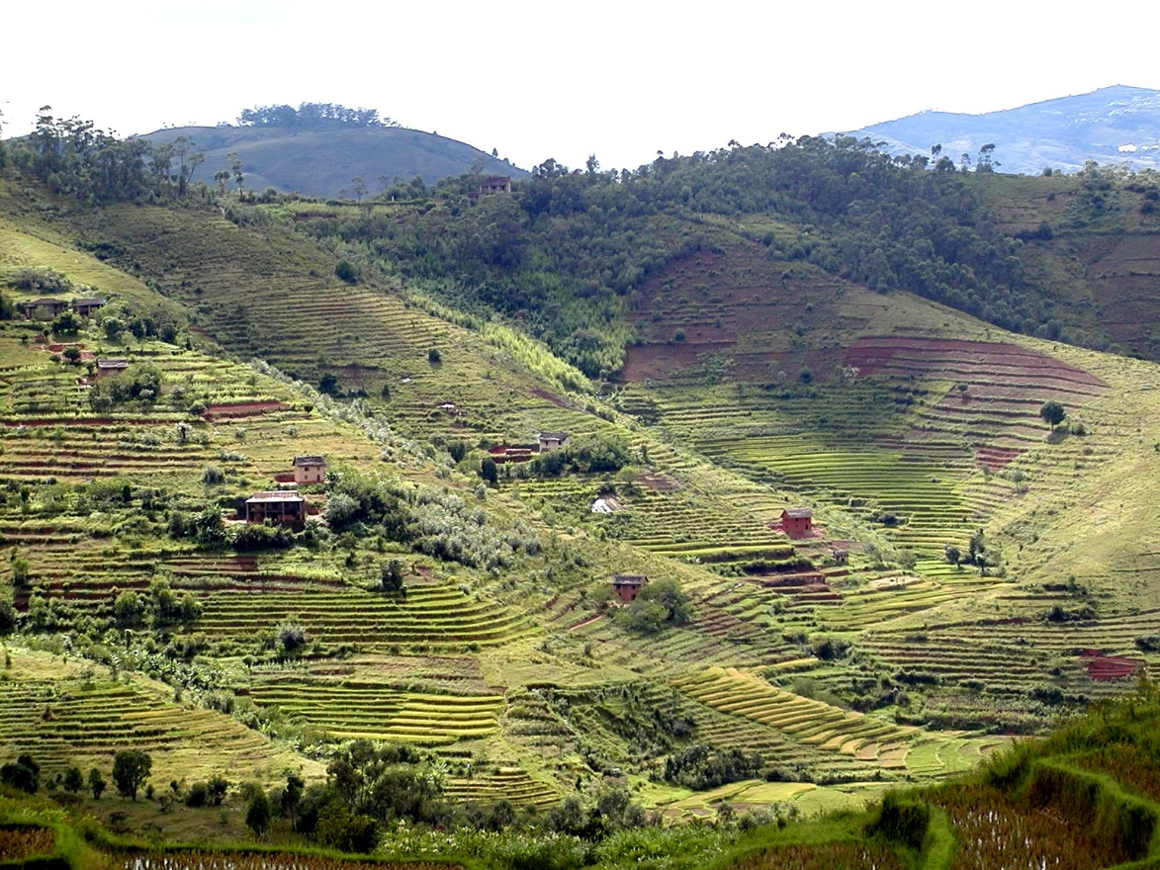
Availability challenges
Planetary boundaries will limit input expansion.
Arable land essentially fixed w/o major (ecol. risky) conversion of forest, wetlands, or drylands, esp in Asia
Soil nutrient depletion (esp. N, P and minerals)
Increasing urban/protected area competition for land
Ag already accounts for ~70% of human water usage, > 80% in Africa and Asia, climate changes makes worse
Marine capture fisheries stable or declining

Slide 18
Availability challenges
So must rely mainly on technological advances to boost agricultural productivity. But…
  Slowing growth in yields (esp. w/climate change and changing range/prevalence of pests and pathogens)
  Site specificity due to agroecological heterogeneity
  Innovation most needed in Africa/Asia, where demand growth will occur but ag R&D capacity also most limited
  Technological advance requires investment, and governments and philanthropies are essential but insufficient … will rely heavily on the private sector.
  Private IP regimes increasingly pose obstacles
  Ongoing opposition to GMOs/gene editing

Slide 19
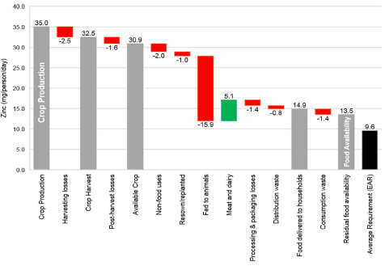
Availability challenges
Challenge: loss/waste of key nutrients along the value chain from crop production to human consumption
Source: Ritchie et al. 2018 FSFS
For some nutrients (calcium, folate) residual food availability <10% >DRs.
Keep in mind, however, loss/waste endogenous to prices.

Slide 20
Science and solidarity
We need innovations
  Greater efficiency in use of increasingly scarce natural inputs to boost total factor productivity
  More efficient post-harvest distribution and processing to reduce loss/waste and prices
  Secure land/water tenure for farmers/herders
  Intellectual property regimes to accelerate discovery
  … in and for Africa and Asia, especially

Slide 21
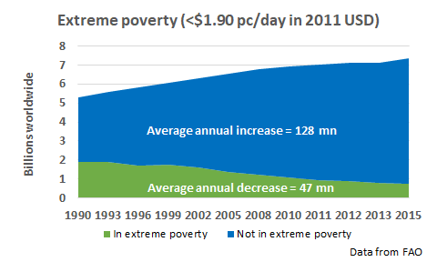
Access progress
“Starvation is the characteristic of some people not having enough food to eat. It is not the characteristic of there being not enough food to eat.” (emphasis in original)
- Opening sentences, Amartya Sen, Poverty and Famines, 1981
Poverty is the key driver of food insecurity/undernutrition. Historically unprecedented decline in global poverty, plus declining real food prices, dramatically improved food access.

Slide 22
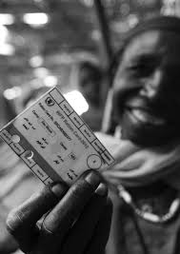
Access progress
Safety nets, incl. employment guarantee schemes, have dramatically expanded access for the poor:
130 low- and middle-income countries now have at least one non-contributory cash transfer program (Bastagli et al. ODI 2016)
~1.5 bn benefit from gov’t-based food assistance programs (mostly in-kind) (Alderman et al. 2018)
Professionalization of emergency response by humanitarian organizations has dramatically improved early warning and targeting, and accelerated response times.
Photo credit: ODI

Slide 23

Access challenges
Poverty traps arise when self-reinforcing feedback from poor ‘initial conditions’ lead to optimal behaviors that perpetuate poverty. As global poverty rates fall, the toughest cases remain, concentrated in the most remote, dangerous places.
Examples:
- malnutrition causes poverty, which itself leads to further malnutrition (lifelong for kids).
- high risk exposure leads to risk averse livelihood strategies that lock in poverty.
- discrimination against certain identities discourages people from acquiring skills, thereby reinforcing harmful stereotypes.
- shocks cause psychological trauma that dampens hope and increases stress, reducing effort, investment and productivity.

Slide 24
Science and solidarity
Must advance the poor’s access …
to new technologies: save lives and enhance livelihoods. Example: mobile money, irrigation, IBLI, AI for EWS
to finance: savings/insurance/credit to enable investment and shield against shocks
to markets (esp. labor/commodity mkts): fair, competitive exchange enhances the value of what the poor own/produce
to safety nets: need reliable protection against grave dangers, esp. those that directly or indirectly imperil health
to early childhood health, nutrition and education
… empower the poor to invest in human (and other)
capital and thereby realize full potential and flourish

Slide 25
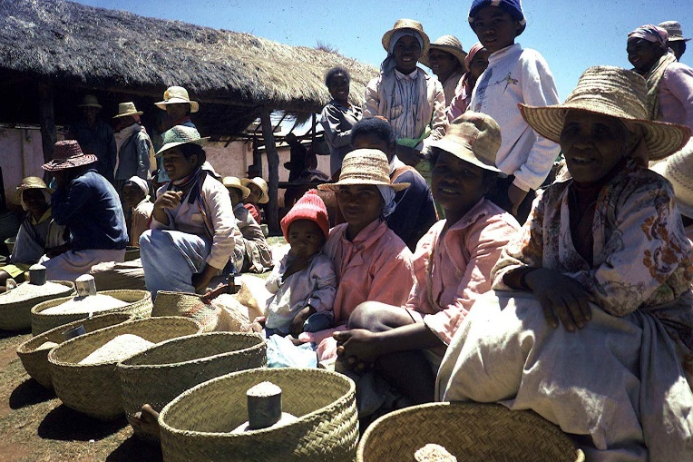
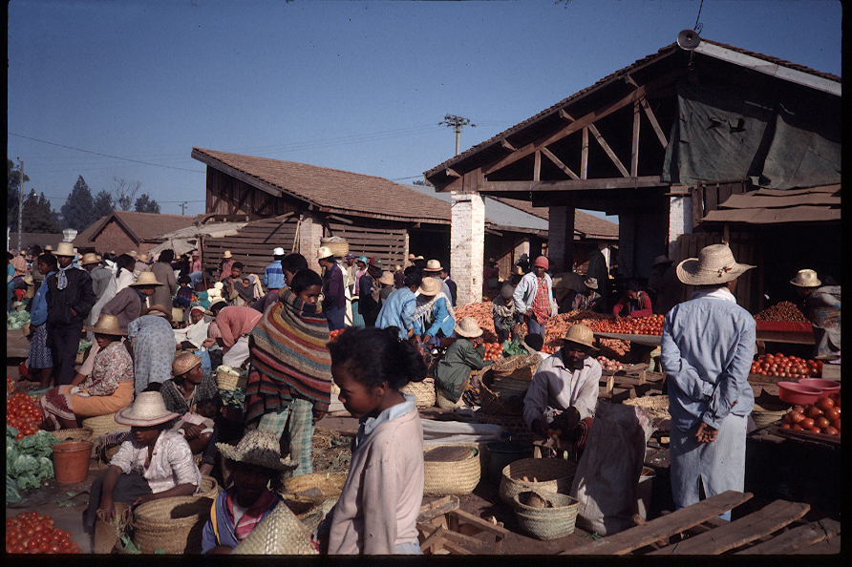
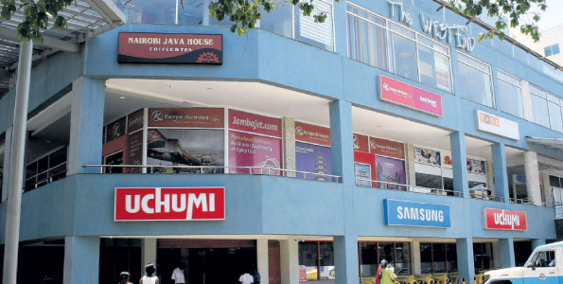
Utilization challenges
75-80% of food consumed w/n country where grown Food system performance improvements must occur in Africa/Asia, where most demand growth will be greatest.
w/urbanization, income growth, post-harvest value chains grow ever more important. Must move beyond staples …
Store photo credit: Business Daily Africa

Slide 26
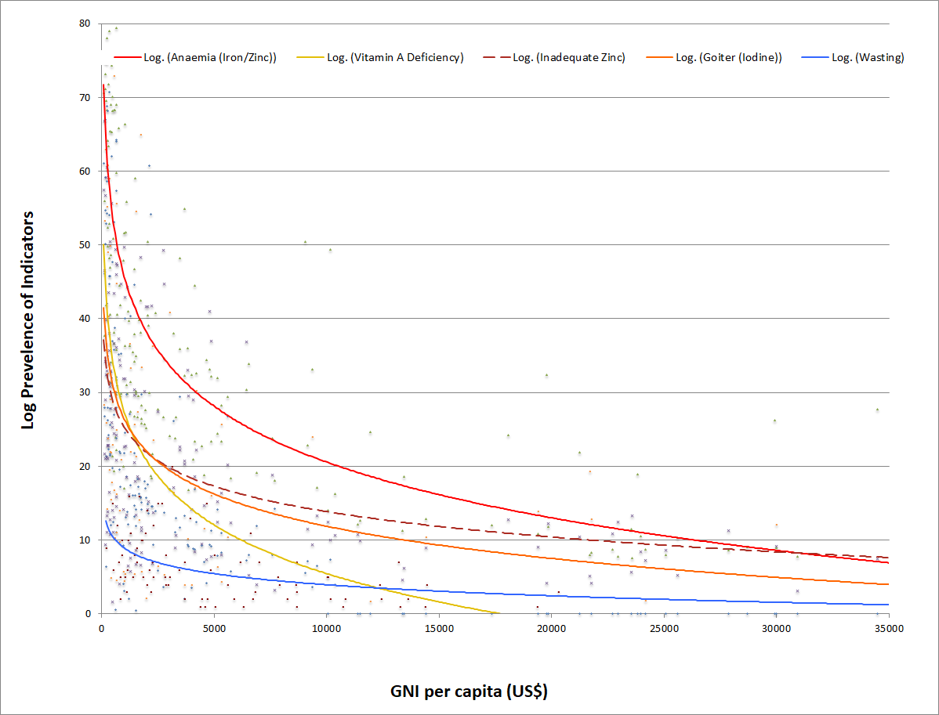
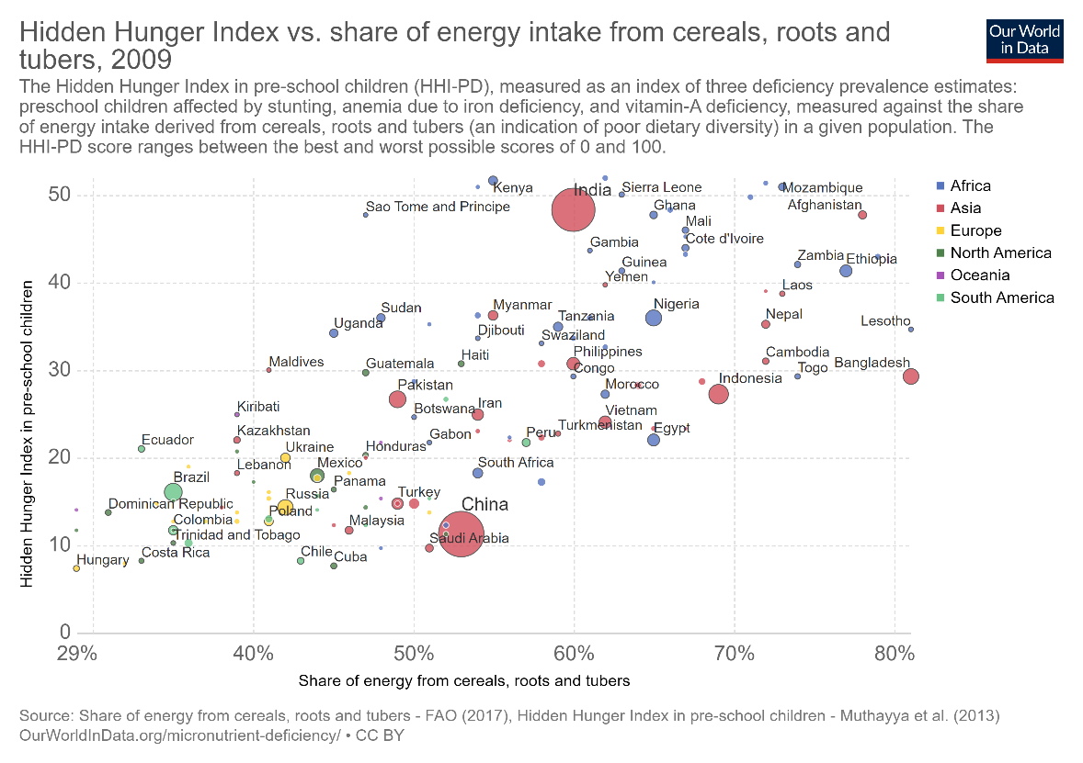
Utilization challenges
Micronutrient deficiencies – ‘hidden hunger’ – are less responsive to income growth. Require dietary change and/or change in mineral/vitamin content of staple foods.
Source: Barrett and Bevis, 2015

Slide 27
Utilization challenges
Micronutrient deficiencies persist longer…
Countries by malnutrition problem and ag productivity (SOFA 2013)

Slide 28
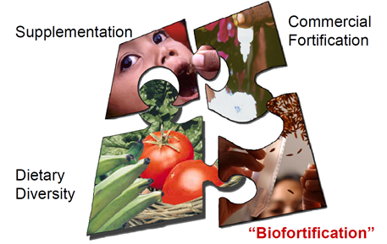
Science and solidarity
Need complementary innovations upstream (biofortification, fertilizers), midstream (fortification in processing) and downstream (consumer behavior change)
Graphic credit: Ross Welch/Mike Gore

Slide 29

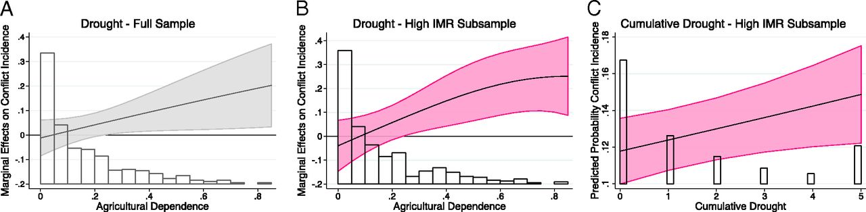
Increased co-location of food insecurity with conflict
Stability challenges
Over past 2 decades, conflict-affected countries’ share of stunted children grew from 46% to 79%. (FAO et al. 2017)
According to UNHCR, a record ~69mn forcibly displaced people globally now.
And strong relationship between drought and conflict (von Uexkul et al. 2016 PNAS)

Slide 30
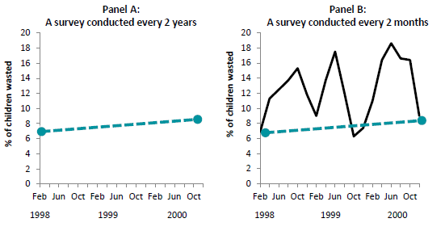
Stability challenges
Further improvements will require investments in high-frequency longitudinal data from locations with the most vulnerable populations.
Example: the value of intra-seasonal monitoring:
Data from HKI Bangladesh Nutrition Surveillance Program
Need sentinel sites (Barrett Science 2010, Headey & Barrett PNAS 2015)

Slide 31
A sustainable food secure future for all requires innovations:
1. In growing the downstream supply of minerals and vitamins from vegetables, fruits, and animal source foods.
2. Accelerating adaptation to climate change, water scarcity, and improving soil nutrient cycling in food production.
3. Food value chain enhancements to improve access, utilization, and stability.
4. Enhanced social protection and safety nets for the poorest.
5. Efforts to reduce conflict.
6. Better monitoring/measurement to improve management.
Science and solidarity

Slide 32

Thank you
Thank you for your time, interest and comments!

